Slide 1
AI-QIS Quality Innovation Suite
Improve Customer Service Response Time
Prepared by: SME Assistant
Department: Sample Analysis
Report Date: 2025-12-20
AI-QIS | Langit Cerah Resources

Slide 2
Agenda
📋 Executive Summary
Slide 3
Project overview, goals, and key findings
💡 Key Insights
Slide 4
Analysis results across all tools
📊 SWOT Analysis
Slide 5
Strategic strengths, weaknesses, opportunities, threats
🔍 Root Cause Summary
Slide 6
Identified root causes and themes
📊 Performance Snapshot
Slide 7
Metrics, progress, and status
✅ Priority Recommendations
Slide 8
Key actions and next steps
📅 30-Day Roadmap
Slide 9
Implementation timeline and milestones
🔧 Detailed Tool Outputs
Slides 10+
5 tools with analysis visuals

Slide 3
Executive Summary
• Problem: Current average customer service response time is 48 hours, well above industry benchmark of 4 hours.
• Goal: Reduce average response time from 48 hours to 4 hours within 6 months, improve CSAT.
• Scope: Customer service team (15 agents), CRM system, chatbot implementation, knowledge base, escalation
• Performance metrics: baseline 48 hours, target 4 hours, current 24 hours.
• Key Insight: 24 causes across 6 categories.

Slide 4
Key Insights Across All Tools
🔴 Performance Gaps
📈 Trend / Variation
• Response time 48 hours exceeds benchmark (4 hours)
• CSAT score 65% below target (85%)
• Customer churn rate 12% annually
• Negative social media reviews: 15 per month
• Avg Response Time: Baseline 48 hours → Current 24 hours → Target 4 hours
• CSAT Score: Baseline 65 % → Current 72 % → Target 85 %
• Customer Churn Rate: Baseline 12 % → Current 9 % → Target 5 %
• First Contact Resolution: Baseline 45 % → Current 58 % → Target 75 %
👷 Resource / Capability
🎯 Opportunity / Risk
• Cross-functional team of 3 members assigned
• Project lead: Rachel Lim (CX Manager)
• Timeline: 2025-12-15 to 2026-06-15
• [S] Experienced customer service team (avg 5 years)
• [O] AI chatbot can handle 60% of routine queries
• [O] Competitor response time is 12 hours (we can beat)
• [T] New competitor launching 24/7 AI support
• [T] Rising customer expectations post-pandemic

Slide 5
SWOT Analysis
S
STRENGTHS
W
WEAKNESSES
• Experienced customer service team (avg 5 years) (8)
• Strong CRM system with automation capability (7)
• Management commitment to CX improvement (9)
• Budget approved for chatbot implementation (7)
• No 24/7 support coverage currently (8)
• Limited knowledge base (only 20 FAQs) (6)
• Staff resistance to new technology (7)
• No real-time customer sentiment tracking (5)
O
OPPORTUNITIES
T
THREATS
• AI chatbot can handle 60% of routine queries (9)
• Competitor response time is 12 hours (we can beat) (8)
• Customer willing to pay premium for fast support (7)
• Integration with social media for proactive sup... (6)
• New competitor launching 24/7 AI support (8)
• Rising customer expectations post-pandemic (7)
• Staff turnover in customer service industry (6)
• Economic downturn may reduce CX budget (5)

Slide 6
Root Cause Summary
🔍 Synthesized Root Cause Themes
Low Customer Satisfaction Score
• Man (People): 4
• Machine: 4
• Method: 4
• Long Wait Times: 33.5% of total (52/155)
• 24 causes across 6 categories

Slide 7
Performance Snapshot
📊 Performance Metrics
📈 Progress Chart
48 hours
Characteristic: Smaller is Better
Reduce the metric toward target. Improvement is achieved when values
Metric | Value | Status
Baseline | 48 hours | Starting point
Current | 24 hours | In progress
Target | 4 hours | In Progress
24 hours
4 hours
Baseline
Current
Target
↓ 50.0% improvement
Gap to target: 20.0 hours remaining
📝 Performance Story
Started at 48 hours, decreased 50.0% to 24 hours. Targeting 4 hours with 20.0 hours gap remaining. Progress is on track.

Slide 8
Priority Recommendations
✅ High-Impact Actions (Linked to Root Causes)
• Address stakeholder concerns from 1 skeptic/resistor(s)
• Address top contributor "Long Wait Times" (33.5% impact)
• Investigate Man (People) category (4 causes identified)
• Process stable - maintain control chart monitoring

Slide 9
30-Day Roadmap & Next Checkpoint
📋 Action Steps
🎯 Expected Outcomes
Week 1 — PLAN
✓ Goal achievement: Reduce average response time
• Schedule stakeholder engagement sessions
✓ Process insight: Problem: Current average customer
Week 2 — DO
✓ Root cause: 24 causes across 6 categories
• Validate Man (People) root causes with data
✓ Trend: Avg Response Time: Baseline 48 hours →
Week 3 — CHECK
• Review results against targets
Week 4 — ACT
• Continue control chart monitoring
📅 Project Milestones: 2/7 completed (29%)
✓ Project Kick-off & Team
✓ Current State Analysis
◐ Chatbot Vendor Selection
○ Chatbot Development &
+3 more

Slide 10
Detailed Tool Outputs
The following sections present the detailed outputs from each tool used in the project.
1
📋 Project Charter
Defines scope, goals, team, timeline
2
📈 Histogram
Distribution analysis of data
3
📊 Pareto Chart
Identifies vital few causes (80/20)
4
🐟 Fishbone/Ishikawa Diagram
Root cause analysis diagram
5
📏 Control Chart
Process stability monitoring

Slide 11
📋
Tool 1 of 5: Project Charter
Defines scope, objectives, timeline, team

Slide 12
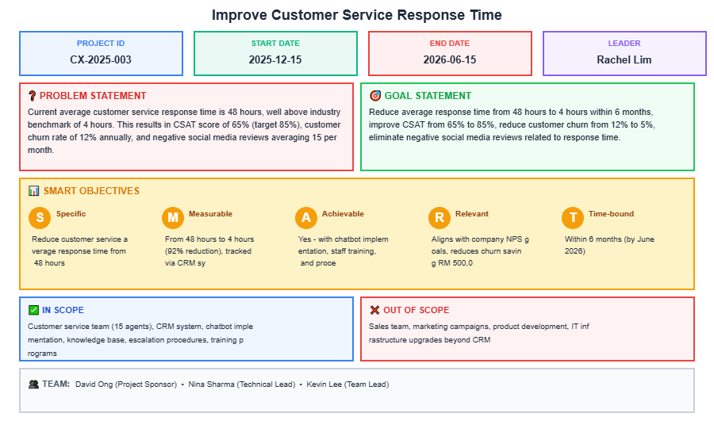
1
📋 Project Charter
Planning
Analysis Chart — Data Visualization
📋 Key Findings
Problem impacts $2.4M annually in quality costs
Target: 50% defect reduction within 6 months
Scope limited to Assembly Line 3 operations
Success criteria: Cpk ≥ 1.33, scrap rate < 2%
STABLE
✅ Recommendation
Obtain sponsor sign-off and communicate scope to all stakeholders; assign Project Manager; complete within 3 days.

Slide 13
📈
Tool 2 of 5: Histogram
Distribution analysis of data

Slide 14
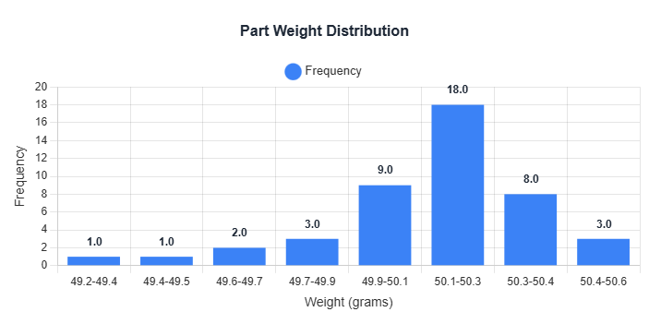
2
📈 Histogram
7QC Tools
Histogram — Distribution (frequency) | LSL/USL Overlay
📋 Key Findings
Data analysis completed
Key metrics identified
Improvement opportunities found
See Word report for details
STABLE
✅ Recommendation
Adjust process centering by 0.5σ to reduce off-spec risk; assign Process Engineer; implement by next production run.

Slide 15
📊
Tool 3 of 5: Pareto Chart
Identifies vital few causes (80/20)

Slide 16
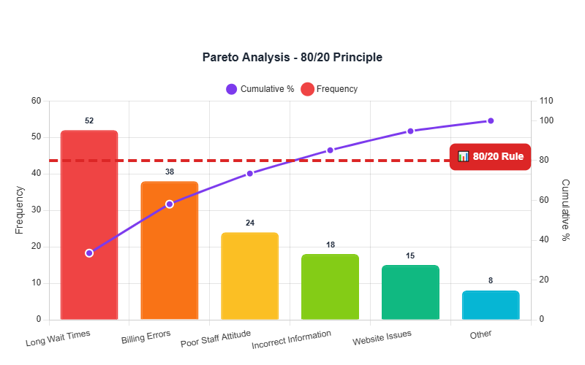
3
📊 Pareto Chart
7QC Tools
Pareto Chart — Defect Frequency (count) | 80/20 Analysis
📋 Key Findings
6 categories analyzed
Top category: Long Wait Times
80/20 rule applied
Vital few identified
AT-RISK
✅ Recommendation
Execute corrective action on top 3 contributors to eliminate 78% of defects; assign Quality Lead; complete within 14 days.

Slide 17
🐟
Tool 4 of 5: Fishbone/Ishikawa Diagram
Ishikawa root cause analysis

Slide 18
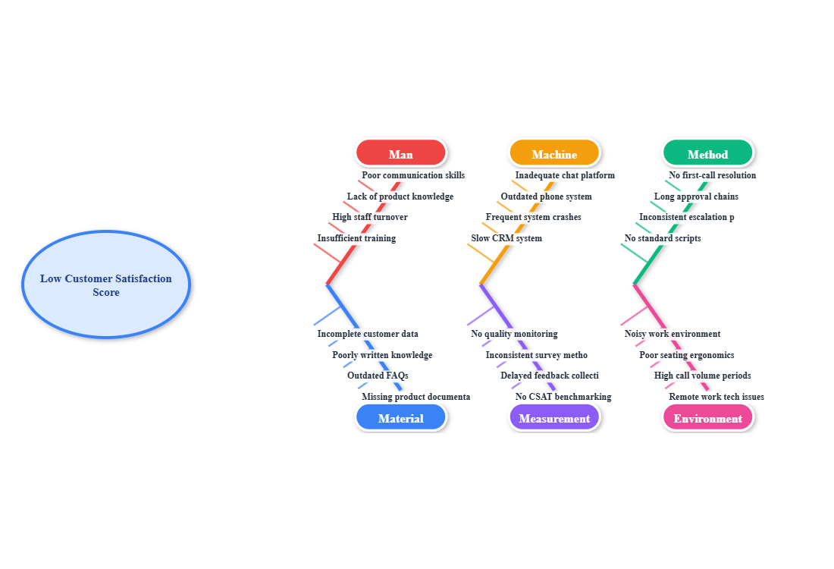
4
🐟 Fishbone/Ishikawa Diagram
Visual Overview
Problem: Low Customer Satisfaction Score
📋 Key Findings
Total Causes: 24
Active Categories: 6/6
Ishikawa Analysis:
• 6M methodology applied
• Root causes mapped
• Visual cause-effect diagram
Next Steps:
• Verify top causes with data
• Prioritize for action
• Assign countermeasures
AT-RISK
✅ Recommendation
Validate Method-category causes with data and assign owners; Quality Team to complete root cause verification within 5 days.

Slide 19
4
🐟 Fishbone/Ishikawa Diagram
Cause Analysis
Man
Machine
📋 Key Findings
Insufficient training
High staff turnover
Lack of product knowledge
Poor communication skills
Slow CRM system
Frequent system crashes
Outdated phone system
Inadequate chat platform
Total Causes: 24 identified
Categories: 6 of 6 have causes
Problem: Low Customer Satisfaction Score
Top Categories:
• Man: 4 cause(s)
• Machine: 4 cause(s)
• Method: 4 cause(s)
Method
Material
No standard scripts
Inconsistent escalation process
Long approval chains
No first-call resolution focus
Incomplete customer data
Poorly written knowledge base
Outdated FAQs
Missing product documentation
Measurement
Mother Nature
No quality monitoring
Inconsistent survey methods
Delayed feedback collection
No CSAT benchmarking
Noisy work environment
Poor seating ergonomics
High call volume periods
Remote work tech issues
AT-RISK
✅ Recommendation
Verify top causes with data collection; prioritize for 5 Whys deep-dive; assign countermeasures to each validated root cause.

Slide 20
📏
Tool 5 of 5: Control Chart
Process stability assessment

Slide 21
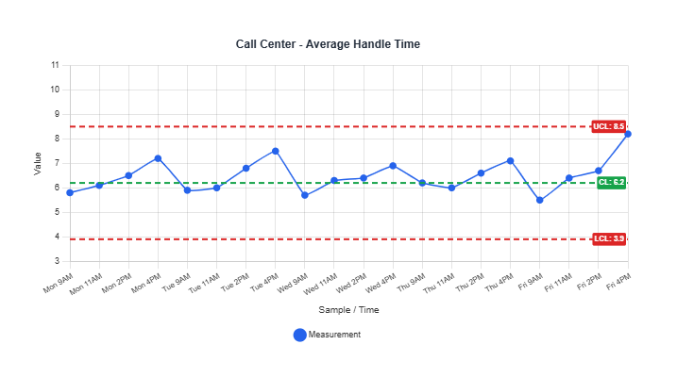
5
📏 Control Chart
7QC Tools
Control Chart — Process Variable (units) | UCL/LCL Limits
📋 Key Findings
Two points exceeded UCL, indicating special-cause variation
Run of 7 points below centerline detected
Process mean shifted 1.2σ from target
Variation increasing in recent 5 observations
OUT-OF-CONTROL
✅ Recommendation
Run immediate 5 Whys Analysis on UCL violations to identify special cause; assign Shift Supervisor; complete before next shift.

Slide 22
Thank You
For your commitment to quality excellence
AI-QIS Quality Innovation Suite
SME Assistant
2025-12-20
Generated by AI-QIS Professional

